Slide 1
a
Cosmology

Slide 2
Concept Question 1
The study of the universe on a large scale, including its origin, evolution, and future, is known as
Astronomy.
Astrophysics.
Cosmetology.
Cosmology.
Universology.
Notes:
Correct answer: D

Slide 3
Concept Question 2
If all the galaxies in the universe were moving about randomly, we would expect to see
All galaxies blue shifted.
All galaxies red shifted.
An approximately equal number of blue shifted and red shifted galaxies.
No blue shift or red shift in the galaxies.
Notes:
Correct answer: C
Roughly half would be moving toward us, and half away from us.

Slide 4
Concept Question 3
In general, the more distant a galaxy is from us,
The faster it is moving away from us.
The faster it is moving toward us.
The slower it is moving away from us.
The slower it is moving toward us.
Notes:
Correct answer: A
Essentially all galaxies are moving away from us, and those that are more distant are moving faster. This observation is consistent with a uniformly expanding universe.

Slide 5
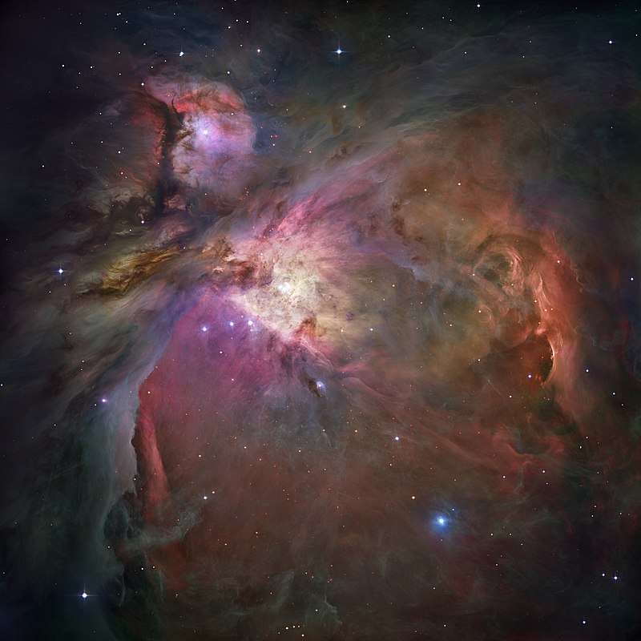
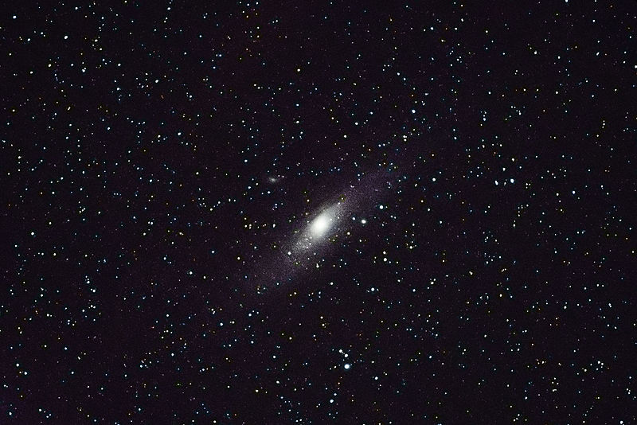
NASA image
US Park Service

Slide 6
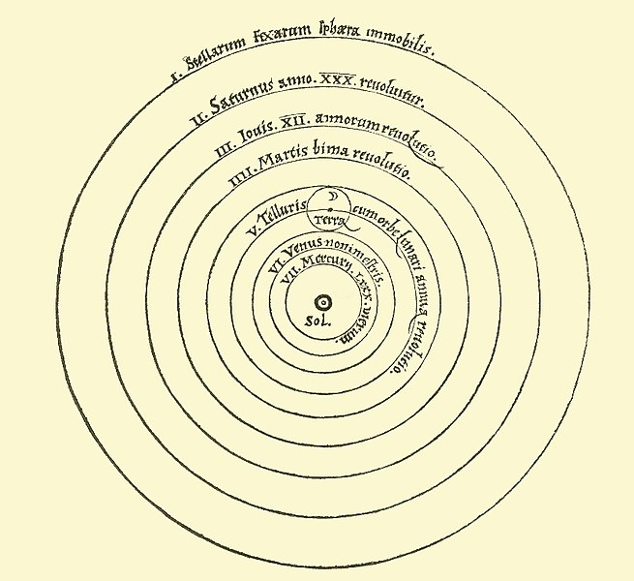
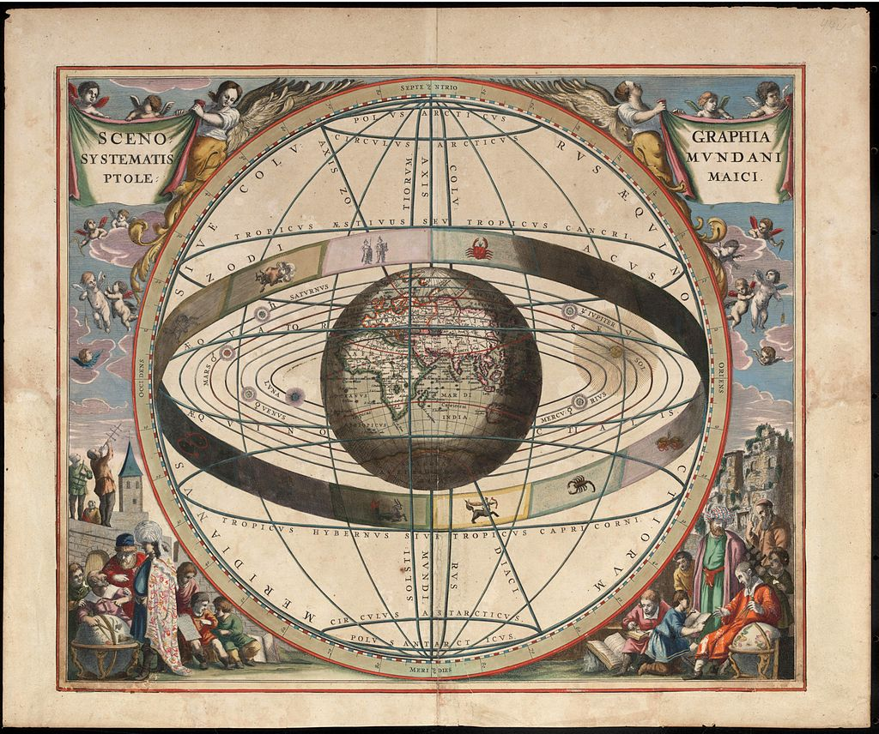
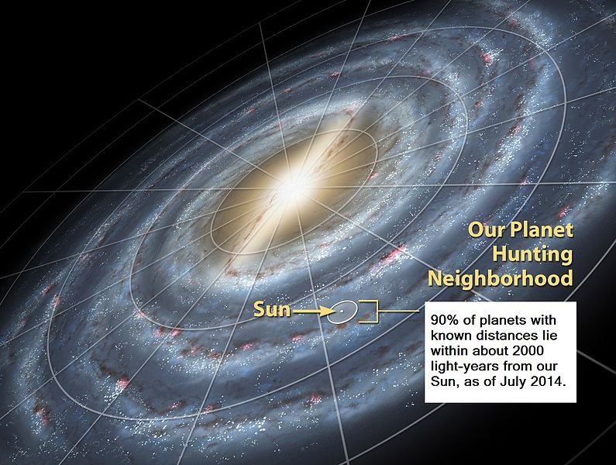

Slide 7
rAB
rAB
A
B
C
D
A
B
C
D

Slide 8
rAB
rAB
A
B
C
D
A
B
C
D
Dot A Reference Frame

Slide 9
rBC
rBC
A
B
C
D
A
B
C
D
Dot C Reference Frame

Slide 10
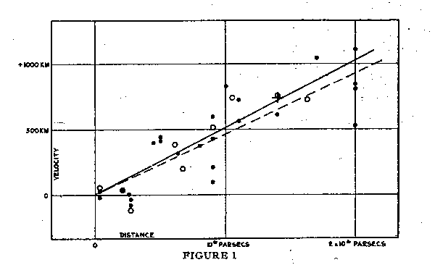
Hubble, E. 1929b, Proc. Nat. Acad. Sci., 15, 168.

Slide 11
Concept Question 4
The Hubble constant has units of inverse time, and 1/H0 gives an approximate age for the universe (i.e. how long ago everything was at one point - the singularity). The best measurements of the Hubble constant suggest that the universe is approximately how old?
~6,000 years.
~10,000 years.
~4.5 billion years.
~14 billion years.
~14 trillion years.
Notes:
Correct answer: D

Slide 12
Concept Question 5
In the big bang model of cosmology, the galaxies are not actually moving. What causes the red shift, then?
Aliens surrounding our galaxy with a bunch of red optical filters.
As the universe expands it also cools, and this cooling reduces the frequency of the light.
As space expands, time is compressed, which causes the relative frequency to decrease.
The space between wave crests is expanding along with all of the rest of the space in the universe.
Notes:
Correct answer: D

Slide 13
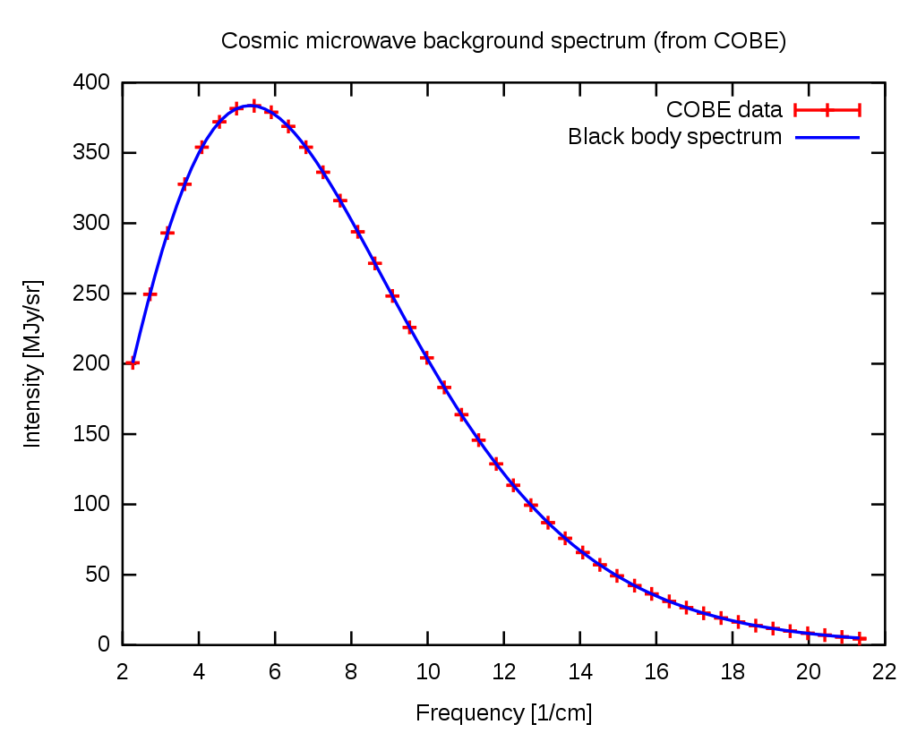
Cosmic Microwave Background (CMB) spectrum plotted in waves per centimeter vs. intensity. The solid curve shows the expected intensity from a single temperature blackbody spectrum, as predicted by the hot Big Bang theory

Slide 14
Concept Question 1
The cosmic microwave background was not always microwaves. The reason it is composed of microwaves today is that
The oscillations responsible for them have decreased in frequency.
The universe has been expanding since those photons were formed.
The universe is cooler than it was in the past.
Notes:
Correct answer: B

Slide 15
Concept Question 2
The temperature associated with the CMB is approximately
0.3 K.
3 K.
30 K.
300 K.
Notes:
Correct answer: B

Slide 16
Concept Question 3
The CMB seems to be coming more strongly (i.e. with higher intensity) from which direction?
From our sun.
From the center of our galaxy.
From the center of our local cluster.
From the center of the universe.
None of the above.
Notes:
Correct answer: E
The CMB is uniform from all directions.

Slide 17
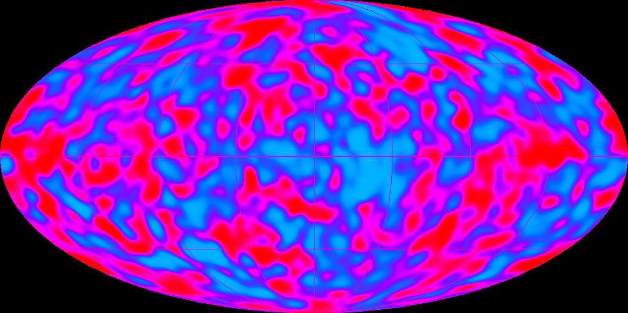
The extremely faint cosmic microwave background fluctuations are only one part in 100,000 compared to the 2.73 degree Kelvin average temperature of the radiation field. The cosmic microwave background radiation is a remnant of the Big Bang and the fluctuations are the imprint of density contrast in the early universe. The density ripples are believed to have given rise to the structures that populate the universe today: clusters of galaxies and vast regions devoid of galaxies. (https://lambda.gsfc.nasa.gov/product/cobe/dmr_image.cfm)

Slide 18
Concept Question 4
The rotational period of a spiral galaxy like ours is
A few centuries.
Tens of thousands years.
A few million years.
A few hundred million years.
Tens of billions of years.
Notes:
Correct answer: D

Slide 19
Concept Question 5
In order to account for the observed rotation of galaxies, what percent of the total matter in the universe must be dark matter?
Less than 5%
About 10-20%.
About 25-35%.
About 50-60%.
About 80-90%.
Notes:
Correct answer: E

Slide 20
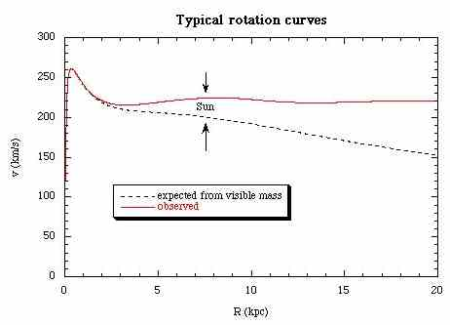
https://www-spof.gsfc.nasa.gov/stargaze/Sun4Adop3.htm

